Slide 1
Convolutional Sparse Coding for High Dynamic Range Imaging
Ana Serrano¹ Felix Heide² Diego Gutierrez¹
Gordon Wetzstein² Belen Masia^{1,3}
¹Universidad de Zaragoza ²Stanford University ³MPI Informatik

Slide 2

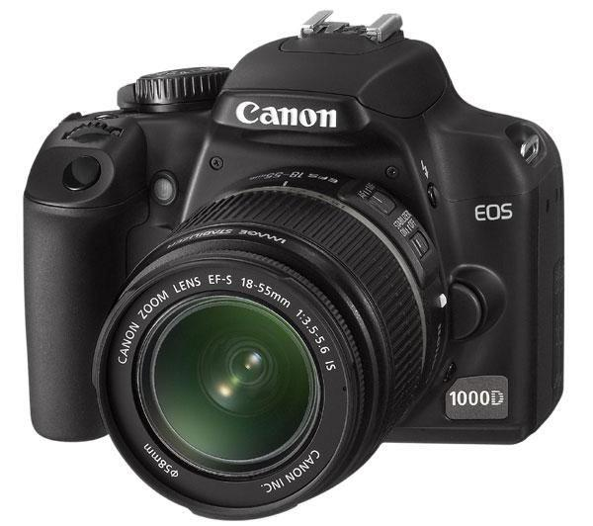
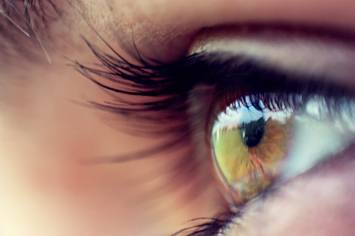
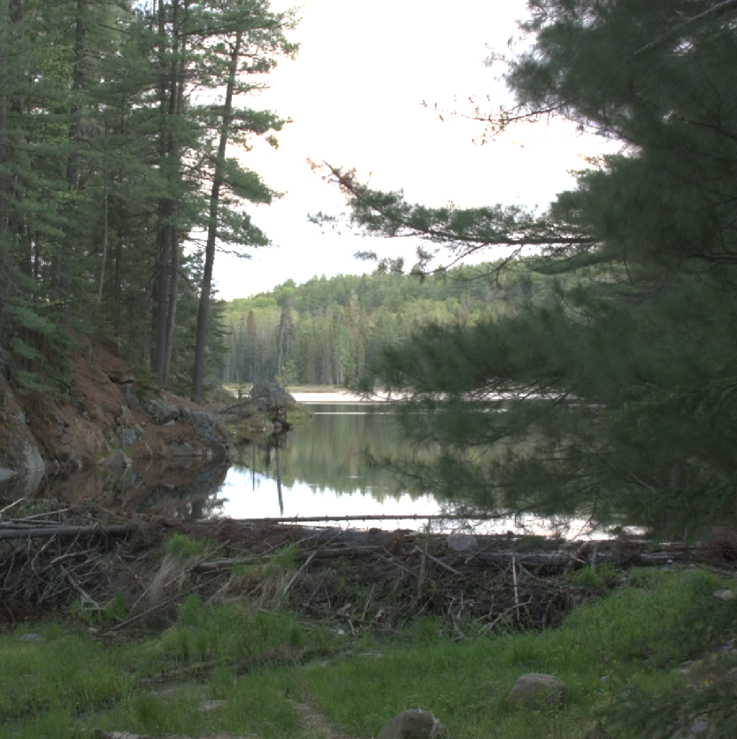
Goal
-3
-2
-1
0
5
log10(L) [cd/m²]
Notes:
High dynamic range imaging is a long-standing problem in imaging and photography. Capture devices have a limited dynamic range which is very narrow if we compare it with the one we can reach with our own eyes. For example in this image, the exposure was set to properly capture the foreground. As a result of the limited dynamic range of the sensor, the sky is completely saturated.

Slide 3
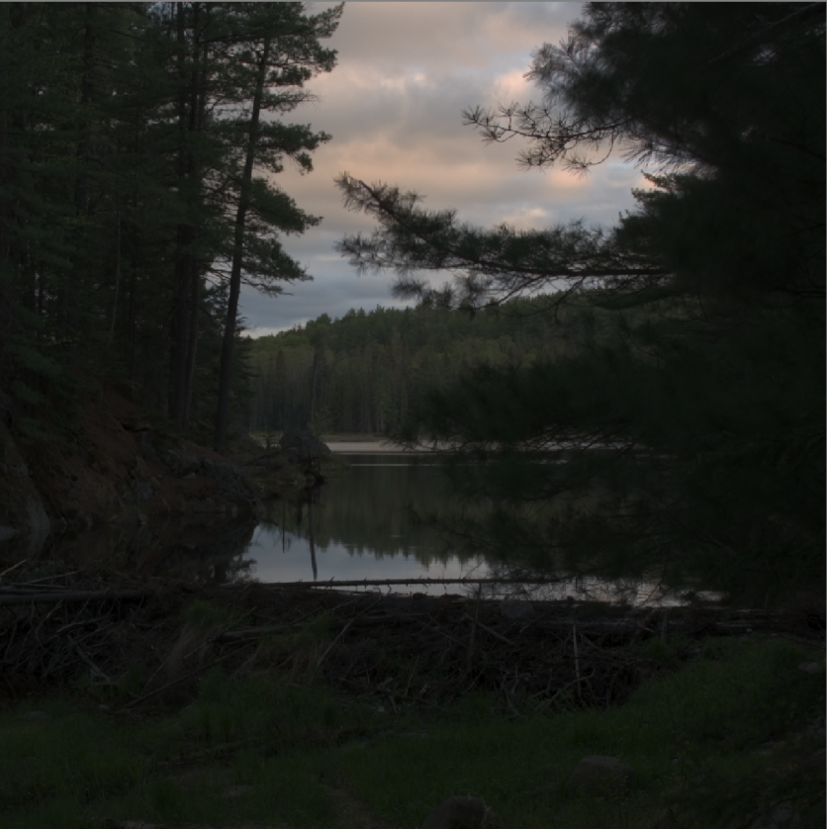
Goal
-3
-2
-1
0
5
-3
-2
-1
0
5
log10(L) [cd/m²]
log10(L) [cd/m²]
Notes:
In this other image, if we set the exposure to capture the sky, the foreground becomes very dark. Typically, the capture of an HDR image is done through multibracketing, where several exposures are captured and then merged together. The problem comes when there is movement either in the scene or in the camera, which will end up with ghosting artifacts. This is even more critical for capturing HDR video.
**MULTIBRACKETING**

Slide 4
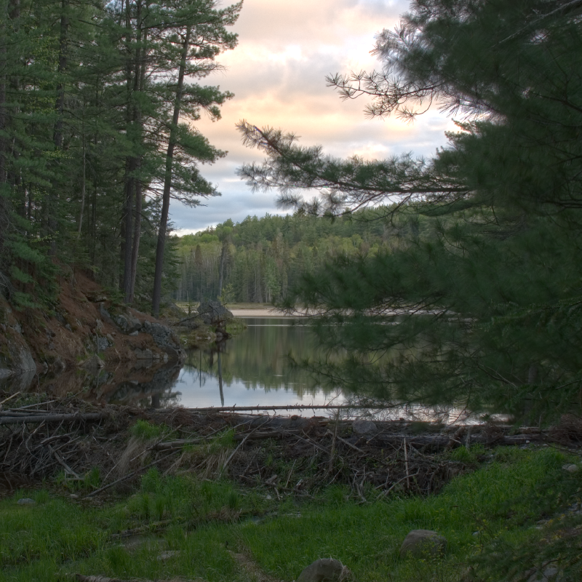
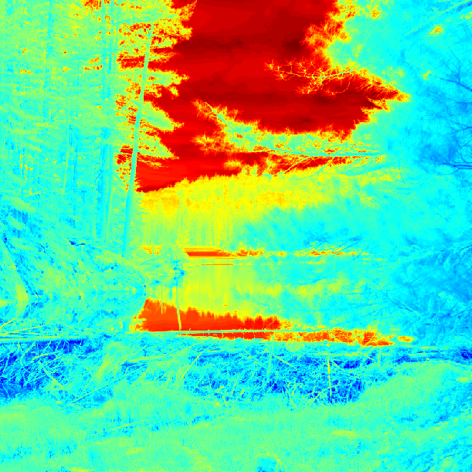
Goal
-3
-2
-1
0
5
log10(L) [cd/m²]
Log2 (stops)
6
3
0
-3
-6
Notes:
So the goal is being able to capture all the dynamic range of a scene in a single shot. Here on the left, you can see the resulting tonemapped HDR image captured with our method with a single shot. In the right you can see the dynamic range as stops color coded.
*SINGLE SHOT**

Slide 5
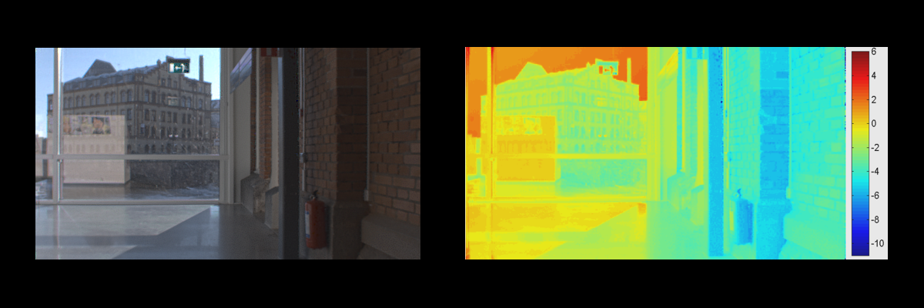
Goal
Recovered HDR Tonemapped
Log2 luminance falsecolor
Simulation – Ground truth from the LiU HDRv Repository (http://www.hdrv.org/)
Notes:
Here is an example of how our framework naturally extends to video.
You can see in the right stops in false color, and in the left the tonemapped recovered frames.
We achieve a very faithful recovery of the original scene, so have a reconstruction without artifacts even if we don’t enforce temporal coherence explicitly.

Slide 6
Previous work – two main approaches
Hardware-intensive
Software-intensive
[Kronander et al. 2013; Tocci et al. 2011;
Batz et al. 2014; Schedl et al. 2014]
[Kalantari et al. 2013; Sen et al. 2012;
Zimmer et al. 2011; Granados et al. 2013]
Our approach
Minimal hardware modification
Unified mathematical reconstruction
Notes:
There are two main approaches for doing this. Hardware-intensive, where hard modifications or custom-made hardware are needed; or software-intensive, that rely in complex post-processing.
We take the best of both sides and place ourselves in the middle. We require minimal hardware modifications and we employ a unified and robust mathematical reconstruction.

Slide 7

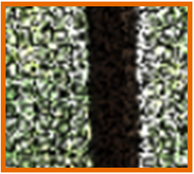
Our approach
1. Coded exposure at the sensor to avoid largely saturated or underexposed areas
    through spatially-varying optical mask
Notes:
mask -> Codes the sensor

Slide 8
Our approach
1. Coded exposure at the sensor to avoid largely saturated or underexposed areas
    through spatially-varying optical mask
2. Employ sparse reconstruction techniques to obtain the final image from the coded exposure
Notes:
Left -> Example of a captured coded image, right -> Its reconstruction

Slide 9


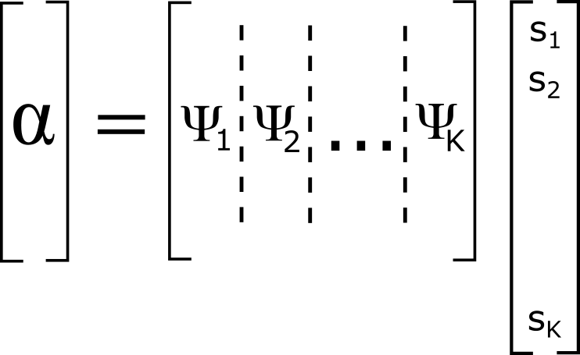
Introduction to sparse coding
Sparse coding models the signal α as a linear combination of dictionary/basis elements Ψ
Basis
Sparse coefficients
Target image

Slide 10
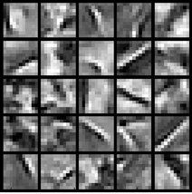
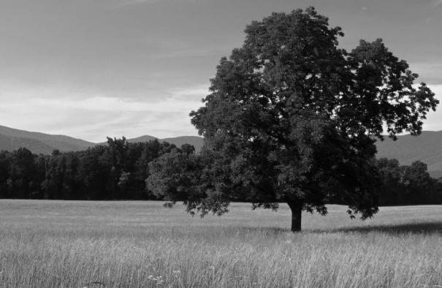





Introduction to sparse coding
Sparse coefficients
Ψ
Basis
α
0.2*
+ 0.7*
+ 0.03*
[s₁, ….., s_{K}] = [0, 0, …, 0, 0.2, 0, …, 0.7, 0, …0, 0.03, 0]
Notes:
**PATCH-BASED**

Slide 11



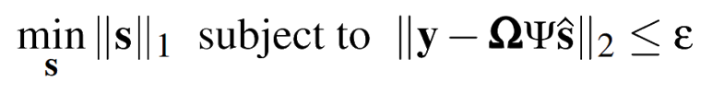
Introduction to sparse coding
Coding mask
Basis
Sparse coefficients
Captured image
Target image
¿?

Slide 12
Sparse coding for HDR
Sparse coding models the signal α as a linear combination of dictionary/basis elements Ψ

Slide 13
Sparse coding for HDR
Sparse coding models the signal α as a linear combination of dictionary/basis elements Ψ
Problem: reconstructing large contrast edges requires too many high-valued coefficients

Slide 14
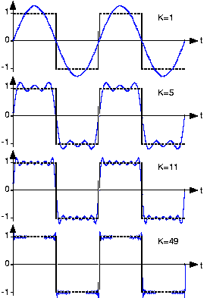
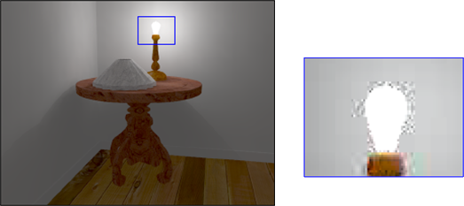
Sparse coding for HDR
Sparse coding models the signal α as a linear combination of dictionary/basis elements Ψ
Problem: reconstructing large contrast edges requires too many high-valued coefficients
[Mantiuk2004]

Slide 15
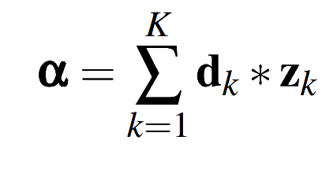
Sparse coding for HDR
Sparse coding models the signal α as a linear combination of dictionary/basis elements Ψ
Problem: reconstructing large contrast edges requires too many high-valued coefficients
Solution: Model it as a convolution

Slide 16
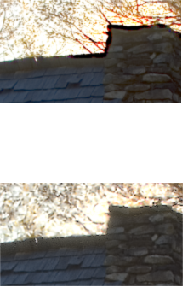
Why convolutional sparse coding?
Global instead of local (patch-based)
  Faster
  Prevents from losing important structures due to subdivision in patches
Patch-based traditional
sparse coding
Convolutional
sparse coding

Slide 17
Why convolutional sparse coding?
Global instead of local (patch-based)
  Faster
  Prevents from losing important structures due to subdivision in patches
Patch-based traditional
sparse coding
Convolutional features
  Richer variance in the learned dictionary
  More degrees of freedom ➔ Ability to represent more complex structures
  (e.g. high-contrast, high-frequency features)
Convolutional
sparse coding

Slide 18
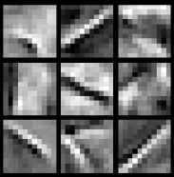

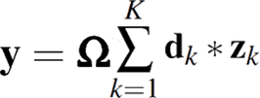
Our approach – Convolutional Sparse Coding
Filters
Sparse maps
Coding mask
Captured image
Target image
*
Trained filters
Sparse maps
Captured image
Target image
Coding mask
Trained filters
Sparse maps
¿?

Slide 19
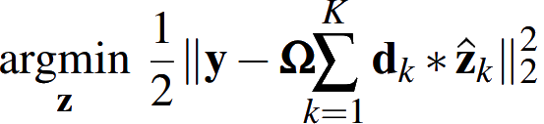
Our approach – Convolutional Sparse Coding
Coding mask
Data term
Trained filters
Sparse maps
Coding mask
Trained filters
Sparse maps
¿?

Slide 20
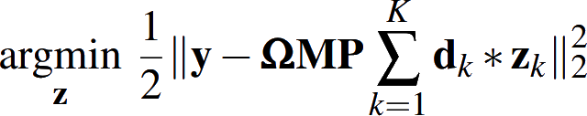
Our approach – Convolutional Sparse Coding
Corrupted pixels
Coding mask
PSF
Data term
Trained filters
Sparse maps

Slide 21
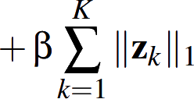
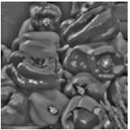
Our approach – Convolutional Sparse Coding
Corrupted pixels
Coding mask
PSF
Data term
Trained filters
Sparse maps
Sparsity
*
Trained filters
Sparse maps
Notes:
**CONTRAST-NORMALIZED**
Generalize to different means and scales and independent of dynamic range

Slide 22
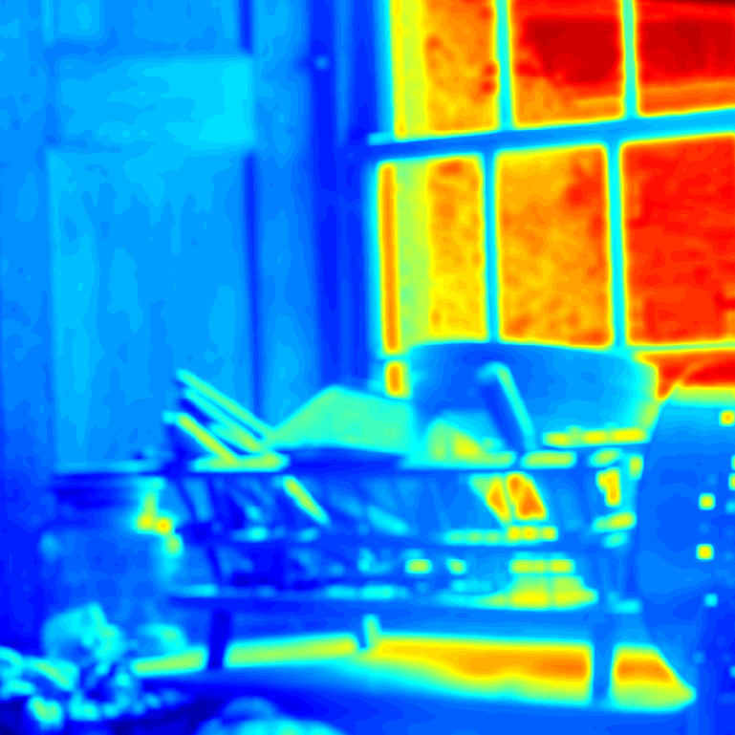

Our approach – Convolutional Sparse Coding
Corrupted pixels
Coding mask
PSF
Data term
Trained filters
Sparse maps
z_{K+1}
Sparsity
Offset estimation

Slide 23
Our approach – Convolutional Sparse Coding
1. Train a filter dictionary - ADMM
Trained filters
Sparse maps

Slide 24
Our approach – Convolutional Sparse Coding
1. Train a filter dictionary - ADMM
Trained filters
Sparse maps
2. Capture the coded image
Coding mask

Slide 25
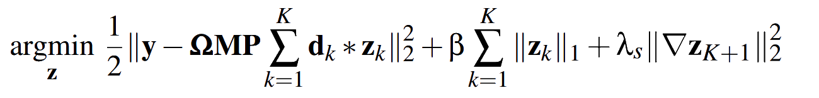
Our approach – Convolutional Sparse Coding
1. Train a filter dictionary - ADMM
Trained filters
Sparse maps
2. Capture the coded image
Coding mask
3. Solve the minimization problem - ADMM

Slide 26
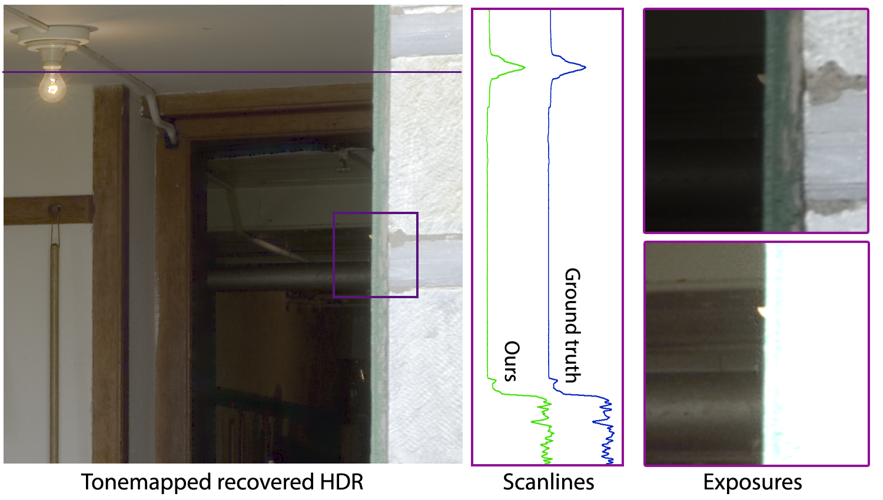
Our approach – Convolutional Sparse Coding

Slide 27
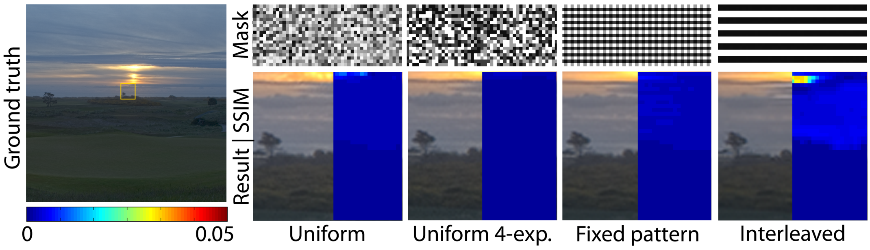
Coding mask
Notes:
**We can work with a wide variety of coding masks**

Slide 28
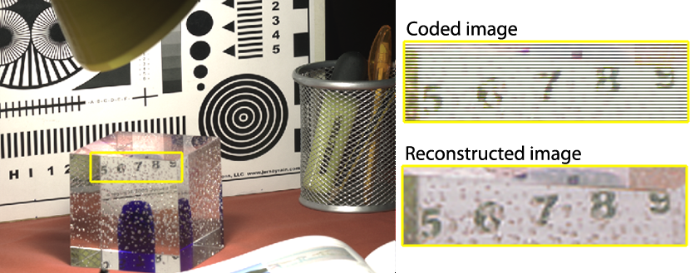
Coding mask – dualISO
Notes:
**In particular interleaved exposures are already available as a plugin for canon cameras**

Slide 29
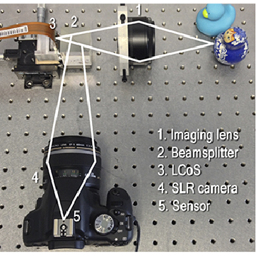
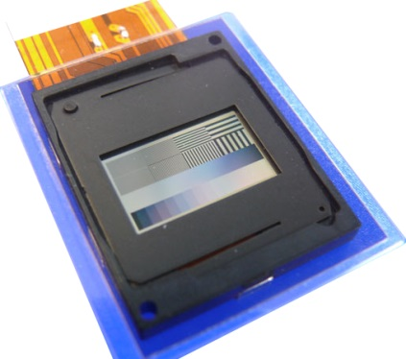
Hardware prototype
LCoS

Slide 30
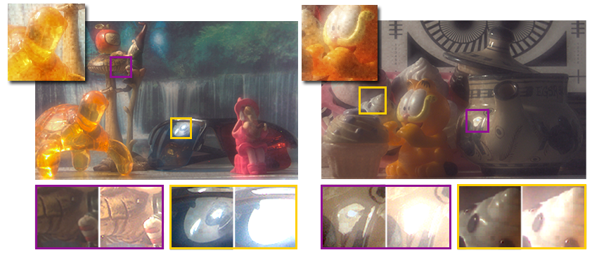
Hardware prototype
Captured
Coded image
Tonemapped HDR
Close-up exposures

Slide 31
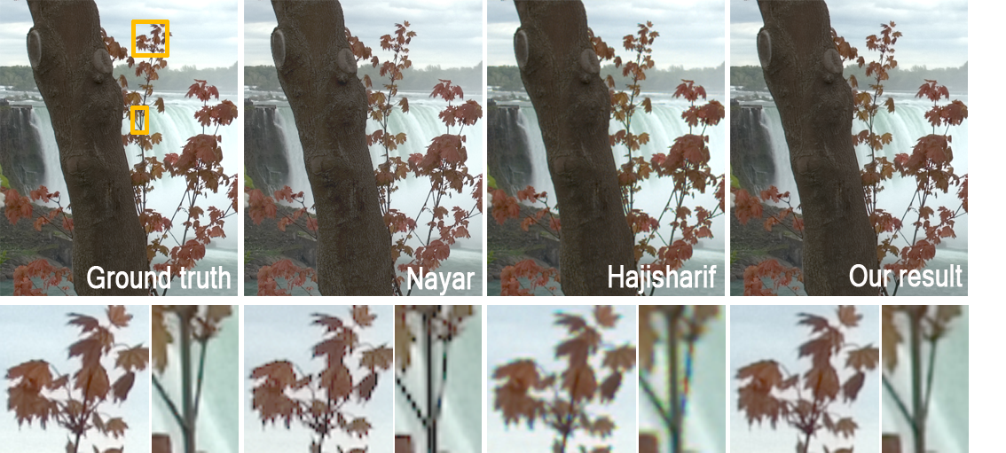
Comparisons
[Nayar02]
[Hajisharif14]

Slide 32
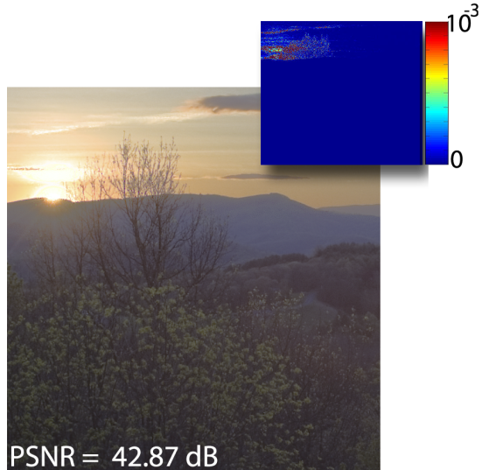
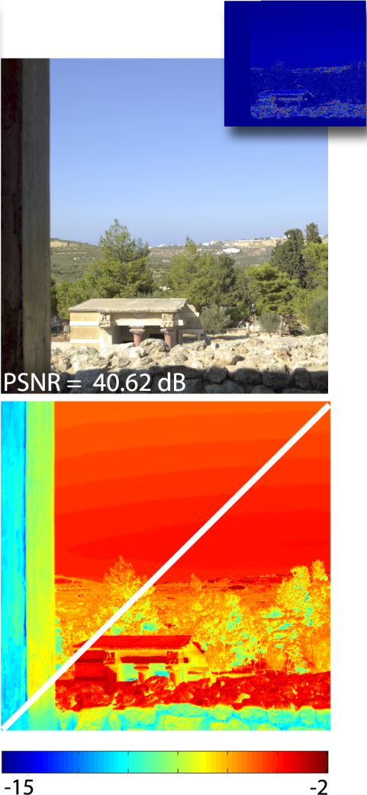
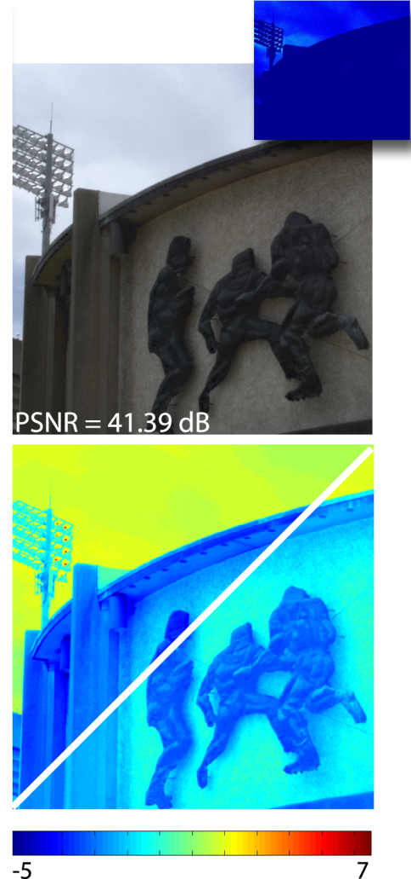
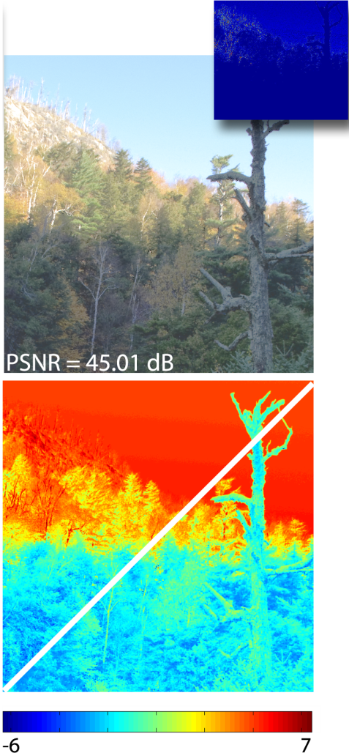
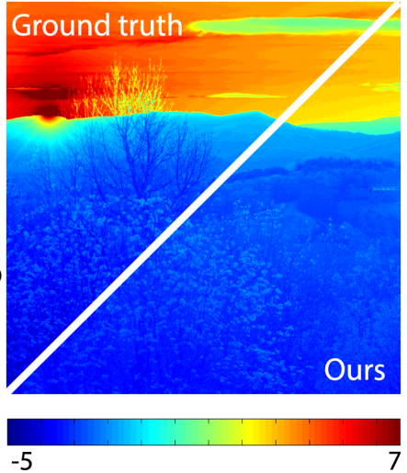
Up to 16 stops
PSNRs above 40 dBs
Results
squared error
Tonemapped
recovered HDR
Log2 (luminance)
Ground truth from the HDR Photographic Survey (http://ritmcsl.org/fairchild/HDR.html), and the EMPA HDR Image Database (http://www.empamedia.ethz.ch/hdrdatabase/index.php)
Notes:
Dynamic range
PSNR
error

Slide 33
Discussion
Benefits & Advantages
Not limited to a number of captured exposures
Accounts for the optical PSF of the system and corrupted pixels
Versatile Framework
  Can be extended for demosaicking
  Can handle a wide variety of coding masks (including dualISO)
Naturally extends to video

Slide 34

Discussion
Benefits & Advantages
Not limited to a number of captured exposures
Accounts for the optical PSF of the system and corrupted pixels
Versatile Framework
  Can be extended for demosaicking
  Can handle a wide variety of coding masks (including dualISO)
Naturally extends to video
Limitations
Very large areas with extremely high dynamic range may result in artifacts
Recovered
Ground truth

Slide 35
Future work
Keep an eye on Sony’s patent development…
Incorporate explicit modeling of image noise to perform denoising in particularly noisy images

Slide 36
Acknowledgements
The anonymous reviewers for their suggestions and comments
Karol Myszkowski, Jose Echevarría, and Adrián Jarabo for insights and discussions
Saghi Hajisharif and Jonas Unger for sharing their results
Nicolas Landa for preliminary tests
Maria Angeles Losada and the Photonic Technologies Group at Universidad de Zaragoza for the optical instrumentation
Spanish ministry of Economy and Competitiveness (FPI grant & project Lightslice)
University of British Columbia
BBVA Foundation
Terman Faculty Fellowship
Intel Strategic Research Alliance on Compressive Sensing
Max Planck Center on Visual Computing and Communications

Slide 37
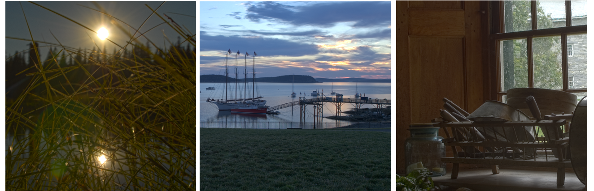
Convolutional Sparse Coding for High Dynamic Range Imaging
Ana Serrano¹ Felix Heide² Diego Gutierrez¹
Gordon Wetzstein² Belen Masia^{1,3}
¹Universidad de Zaragoza ²Stanford University ³MPI Informatik

Slide 38
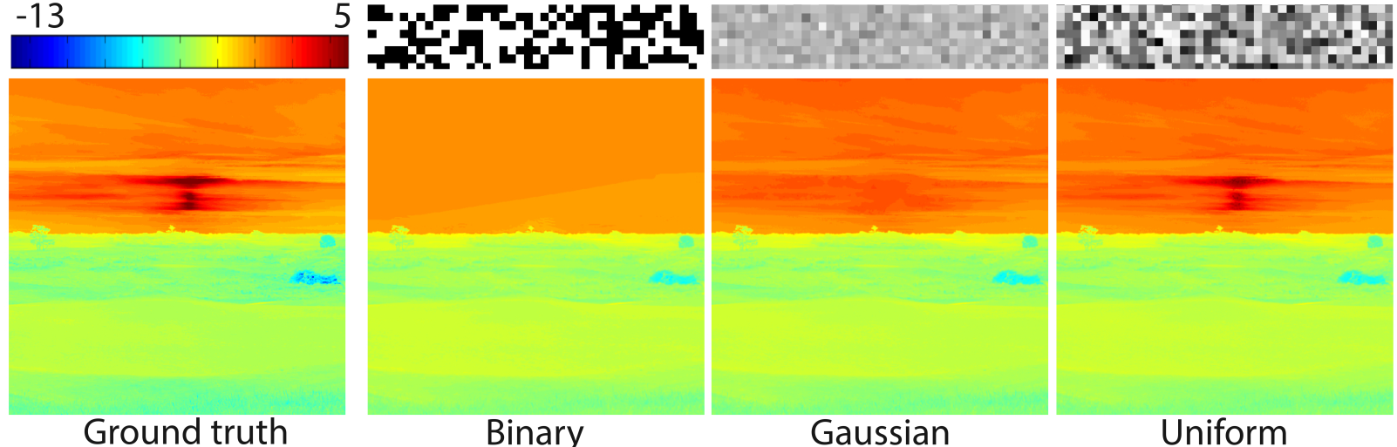
Coding mask
Notes:
Now there is a few things that need to be considered in order to get accurate results.

